Slide 1
DSO-547: Spreadsheet-Based Business Modeling
6. Nonlinear Programming
Hiroshi Ochiumi

Slide 2
Model Classification
Linear optimization or linear programming
Objective and all constraints are linear functions of the decision variables
Nonlinear optimization or nonlinear programming
Either objective or a constraint (or both) are nonlinear functions of the decision variables
Techniques for solving linear models are more powerful
Use wherever possible

Slide 3
Difficulties With Nonlinear Problems
For nonlinear problems, we need to be concerned about local optimal solutions
We seek a global optimal solution
In nonlinear models, either the objective or constraints (or both) can cause problems.

Slide 4
Solver Algorithm for Nonlinear Programming: Hill Climbing
Hill climbing in a fog
Try to follow steepest path going up
After each step, or group of steps, again find steepest path and follow it
Stop if no path leads up
D
●
F
D – Global Maximum
B, F – Local Maxima
B
●
●
●
C
●
●
A
E

Slide 5
Local and Global Optimum
The highest peak is the global maximum
What we want to find
Any peak higher than all points around it is a local maximum
What the solver algorithm locates
Except in special cases, no way to guarantee that a local maximum is the global one
If multiple local maxima exist, which is found depends on starting point of the decision variables

Slide 6
Problems With Nonlinearity
Consider the following problem:
Max f(x,y)
subject to
0 ≤ x ≤ 1
0 ≤ y ≤ 1
Consider three cases:
A linear function: 3x + y
A “nice” nonlinear function:
3-(x-.5)² - (y-.5)²
A “nasty” nonlinear function:
x[sin(5p_{i}x)] + y[sin(5p_{i}y)]

Slide 7
Geometry of the Linear Function

Slide 8
Geometry of the “Nice” Nonlinear Function

Slide 9
Geometry of the “Nasty” Nonlinear Function

Slide 10
Solver Results from Various Starting Points (Nasty Function)
Starting Point
Solution
X | Y | X | Y | Objective
0.0000 | 0.0000 | 0.1292 | 0.1292 | 0.2317
1.0000 | 0.0000 | 0.9045 | 0.0000 | 0.9022
0.0000 | 1.0000 | 0.0000 | 0.9045 | 0.9022
0.5000 | 0.5000 | 0.5079 | 0.5079 | 1.0080
1.0000 | 1.0000 | 0.9045 | 0.9045 | 1.8045

Slide 11
Solving Nonlinear Programs
There may be multiple local optima.
Repeatedly run solver until the message “Solver found a solution…” appears, which suggests a local optimum is reached.
Conduct the search from different starting points to find multiple local optima (if there are) and choose the best one.
OR: Use artificial intelligence approaches such as Premium Solver’s Evolutionary Algorithm, which are designed to overcome local optimal solutions

Slide 12
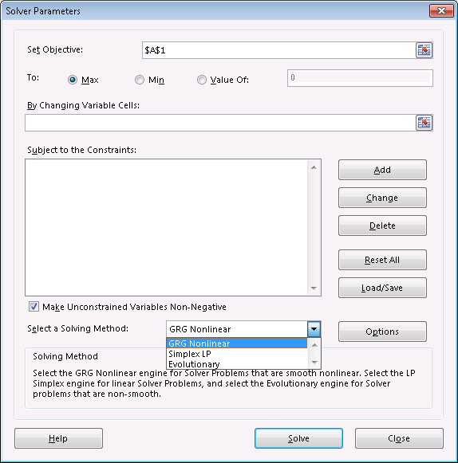
Using Solver for NLPs
Select GRG non-linear algorithm.

Slide 13
Solver Tip: Avoid Discontinuous Function
To be avoided when using solver:
Logical functions: IF, AND, …
Math functions: ROUND, CEILING, …
Lookup and reference functions: CHOOSE, VLOOKUP, …
Reason: Solver cannot handle abrupt cliffs when performing hill-climbing
IF(X<=0, 0, 1) jumps abruptly from 0 to 1 when X reaches 0.

Slide 14
Example: Facility Location
Kilroy Paper Company wants to select the location of a national distribution center (DC)
Locations of 10 major customer sites in the table
Find the DC location to minimize the sum of distances
Site k | x_{k} | y_{K}
1 | 5 | 41
2 | 20 | 10
3 | 44 | 48
4 | 60 | 58
5 | 100 | 4
6 | 138 | 80
7 | 150 | 40
8 | 170 | 18
9 | 182 | 2
10 | 190 | 56

Slide 15
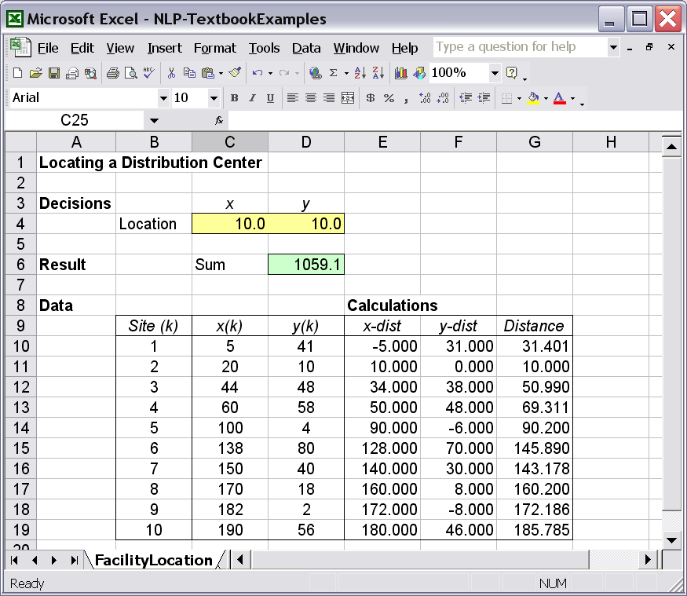
Excel Model

Slide 16
Example: Revenue Maximization (Known Demand Function)
Coastal Telephone Company:
A regional supplier of long-distance telephone services
Daytime price (DP) applies from 8am – 6pm;
Evening price (EP) applies the rest
Average demand for phone lines (per min):
Daytime Dem’d = 600 – 5,000×DP + 300×EP
Evening Dem’d = 400 + 600×DP – 2,500×EP
Find the optimal prices to maximize revenue

Slide 17
The Model
Decisions:
DP (Daytime price), EP (Evening price)
Objective:
Revenue = 600DD×DP + 840ED×EP
where
DD = 600 – 5,000×DP + 300×EP
ED = 400 + 600×DP – 2,500×EP
Why nonlinear?

Slide 18
Modeling Tip: Some Nonlinear Models Have an Unique Optimum
When the objective is a quadratic function (for example, x² + 2y² + 4z² + xy - 3xz + 6z), the solver reliably finds the global optimum.
The previous model fits in this case.

Slide 19
Example: Estimating Relationships (Regression)
A chain of drugstores has pharmacies in different types of locations
A sample of ten stores
A data table (next page) shows the number of hours per week each store is open and its average revenue
Predict revenue as a function of the #hours the store is open. (Curve fitting)

Slide 20
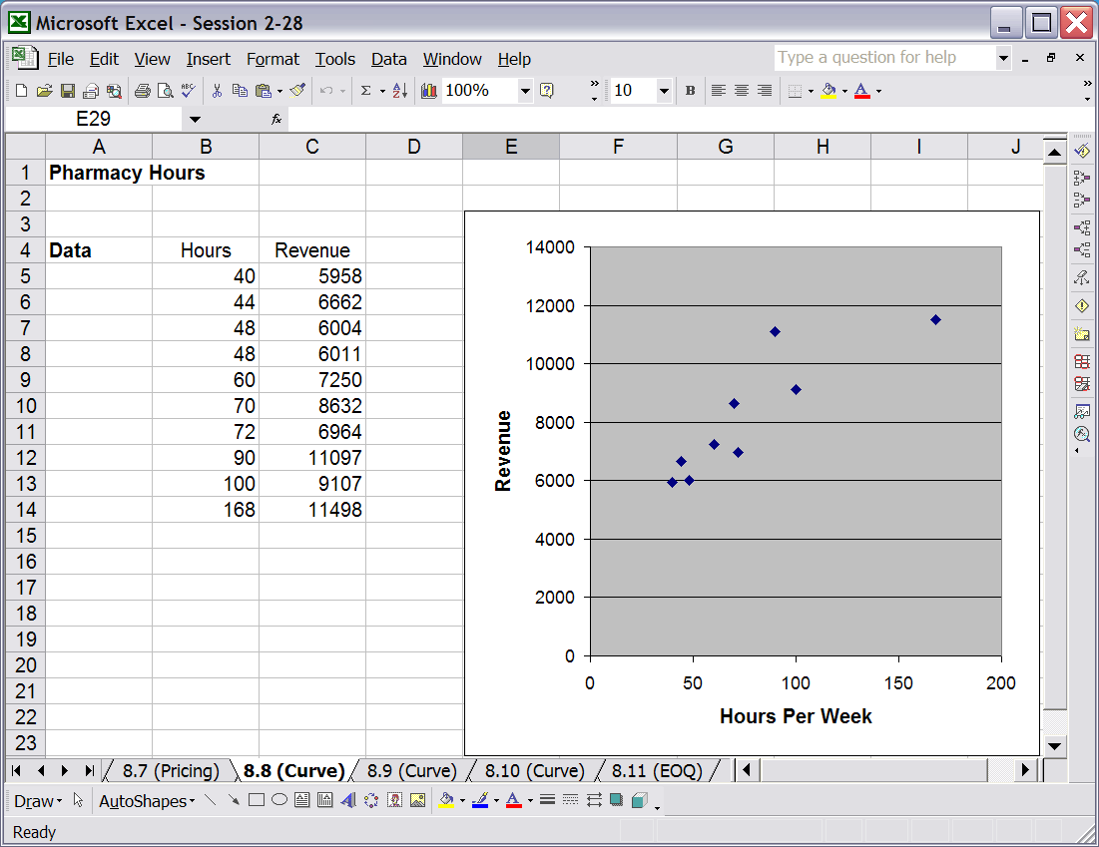
Data

Slide 21
The Model
Hypothesize the relationship:
Revenue = a×(Hours)^{b}
Decision variables: a and b
Objective function:
Minimize the sum of squared differences between the model and the data (least squares)
For each given “Hours”, compute “Revenue” according to the model
Sum the squared differences of the model revenues with the ones from the data

Slide 22
Modeling Tip: Type of Curves
Linear: y = a + bx
Power, increasing returns: y = ax^{b} with b>1
Power, diminishing returns: y = ax^{b} with b<1
Exponential, declining and decaying: y = ae^{-bx}
Exponential, increasing and leveling off:
y = a(1-e^{-bx})
S-shaped, rapid then slowing growth:
y = b + (a-b)[x^{c}/(d + x^{c})]

Slide 23
Extension of The Model
Another relationship:
Revenue = a + b×LOG(Hours)
Another objective function (measure of fit):
Minimize the sum of absolute differences between the model and the data

Slide 24
Example: Portfolio Optimization
Markowitz Portfolio Model
Minimize Portfolio Risk
subject to Expected portfolio return ≥ r
Risk is measured by the portfolio variance

Slide 25
Portfolio
A portfolio consists of n investments
Investment i has one-period return S_{i}
0.10 means $1 invested grows to $1.10
-0.20 means $1 invested is worth of $0.80 one period later
Investment returns S_{i} are random
Expectation of S_{i} is denoted by μ_{i}
Covariance between S_{i} and S_{j} is σ_{ij} (=σ_{ji})

Slide 26
(Cont.)
Percentage of money invested in i is x_{i}
x₁ + x₂ + … + x_{n} = 1
x_{i} ≥ 0 (shorting a stock not allowed)
Expected return of the portfolio
= x₁μ₁ + x₂μ₂ + … + x_{n}μ_{n}

Slide 27
(Cont.)
Variance of the portfolio =
= sum
It can be computed
from the covariance
matrix:
x₁σ₁₁x₁ | x₁σ₁₂x₂ | ... | x₁σ_{1n}x_{n}
x₂σ₂₁x₁ | x₂σ₂₂x₂ | ... | x₂σ_{2n}x_{n}
... | ... | ... | ...
x_{n}σ_{n1}x₁ | x_{n}σ_{n2}x₂ | ... | x_{n}σ_{nn}x_{n}
σ₁₁ | σ₁₂ | ... | σ_{1n}
σ₂₁ | σ₂₂ | ... | σ_{2n}
... | ... | ... | ...
σ_{n1} | σ_{n2} | ... | σ_{nn}

Slide 28
Means, Variances and Covariances can be Estimated from Data
Estimate μ_{i} by the sample average of S_{i}, using AVERAGE()
Estimate σ_{ij} by the sample covariance between S_{i} and S_{j}, using COVAR()
The entire lower triangle of the covariance matrix can be computed by an EXCEL tool:
Tools -> Data Analysis -> Covariance

Slide 29
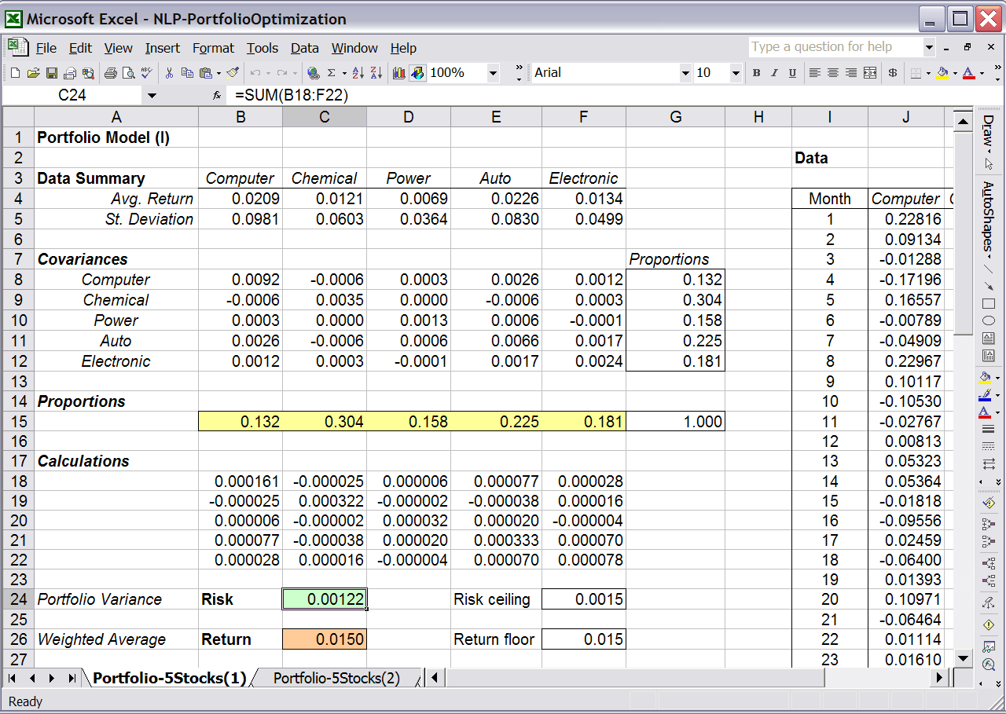
EXCEL Model: Five Stocks

